Slide 1
Enhancing the Segment Anything Model (SAM) with Improved Prompt Encoding and Multi-Scale Feature Fusion for Domain-Specific Segmentation
CS-512 Computer Vision Project
Saurabh Rajput (A20523129),
Arpita Jadhav (A20523353)
Fall 2024

Slide 2
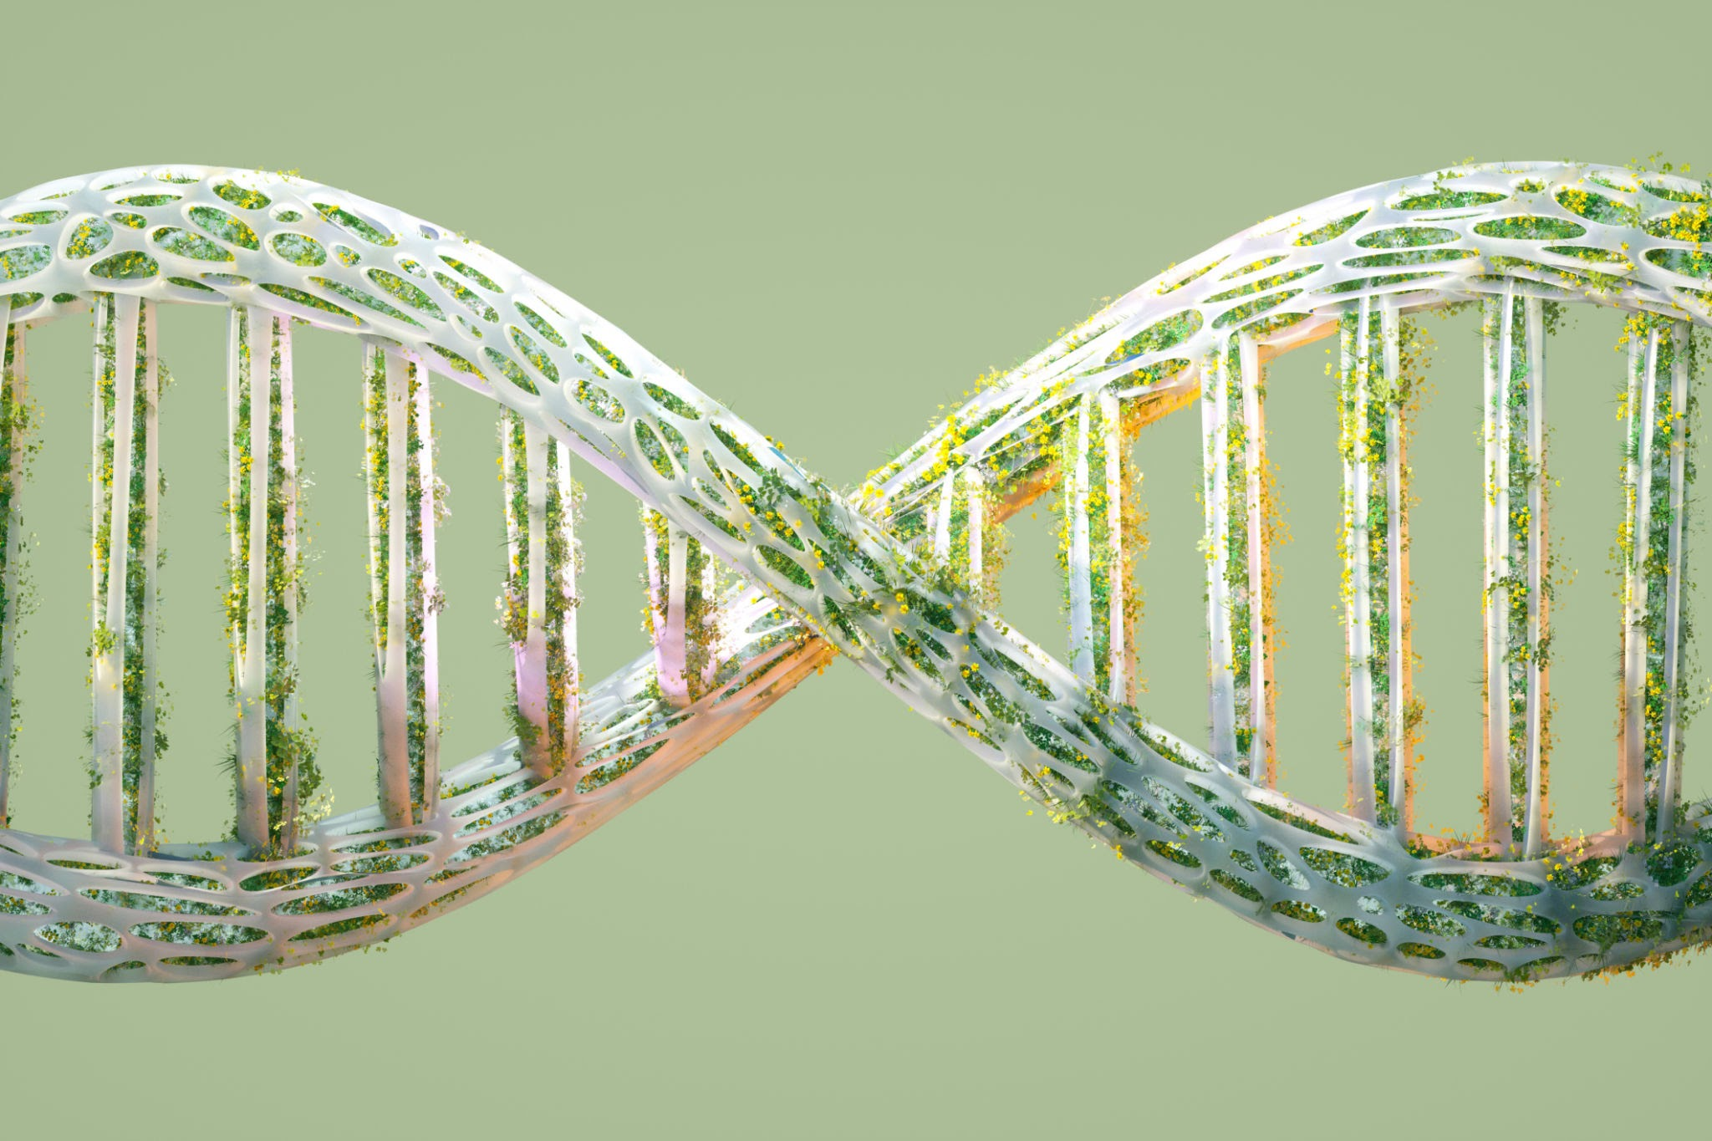
Introduction
CS512 Computer Vision
Fall 24
• SAM by Meta AI is a flexible promptable segmentation model trained on SA-1B dataset with 1 billion masks.
• SAM excels in zero-shot segmentation for diverse fields like medical imaging and autonomous driving.
• Challenges: Limited in specialized tasks needing high precision, scale sensitivity, and contextual adaptation.
• Objective: Enhance SAM’s prompt encoder and feature fusion to improve domain-specific segmentation.

Slide 3
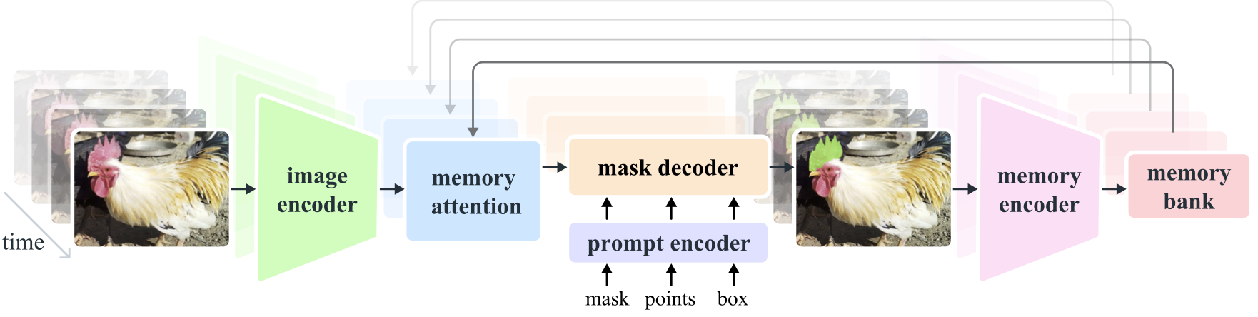
Segment Anything Model (SAM): Architecture
CS512 Computer Vision
Fall 24

Slide 4
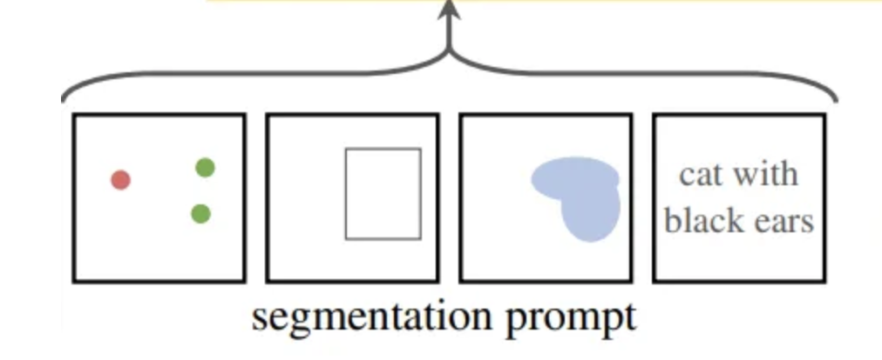
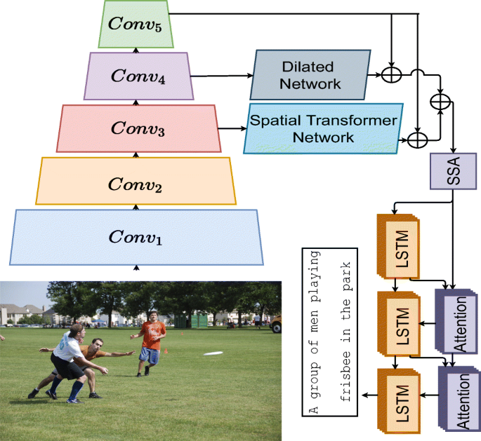
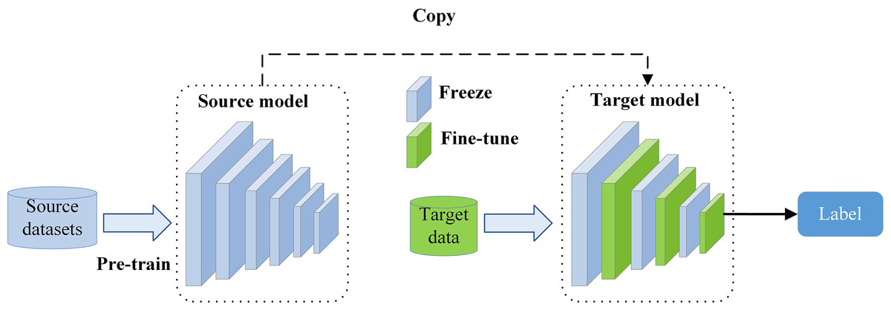
Enhancements to SAM
Enhanced Prompt Encoder:
Multi-Scale Feature Fusion:
- Multi-headed self-attention for precise prompt interpretation.
- Trainable prompt embeddings to differentiate input types.
- Feature Pyramid Network (FPN) for multi-scale object handling.
- Cross-resolution attention for detailed contextual info.
Domain-Specific Fine-Tuning for medical and autonomous driving datasets.

Slide 5
Motivation
• SAM aims for prompt-driven generalization similar to NLP models.
• Gaps: SAM’s limitations in handling domain-specific segmentation, particularly for specialized and scaled segmentation needs.
• Aim: Extend SAM’s flexibility and accuracy for specific applications like medical and autonomous driving.

Slide 6
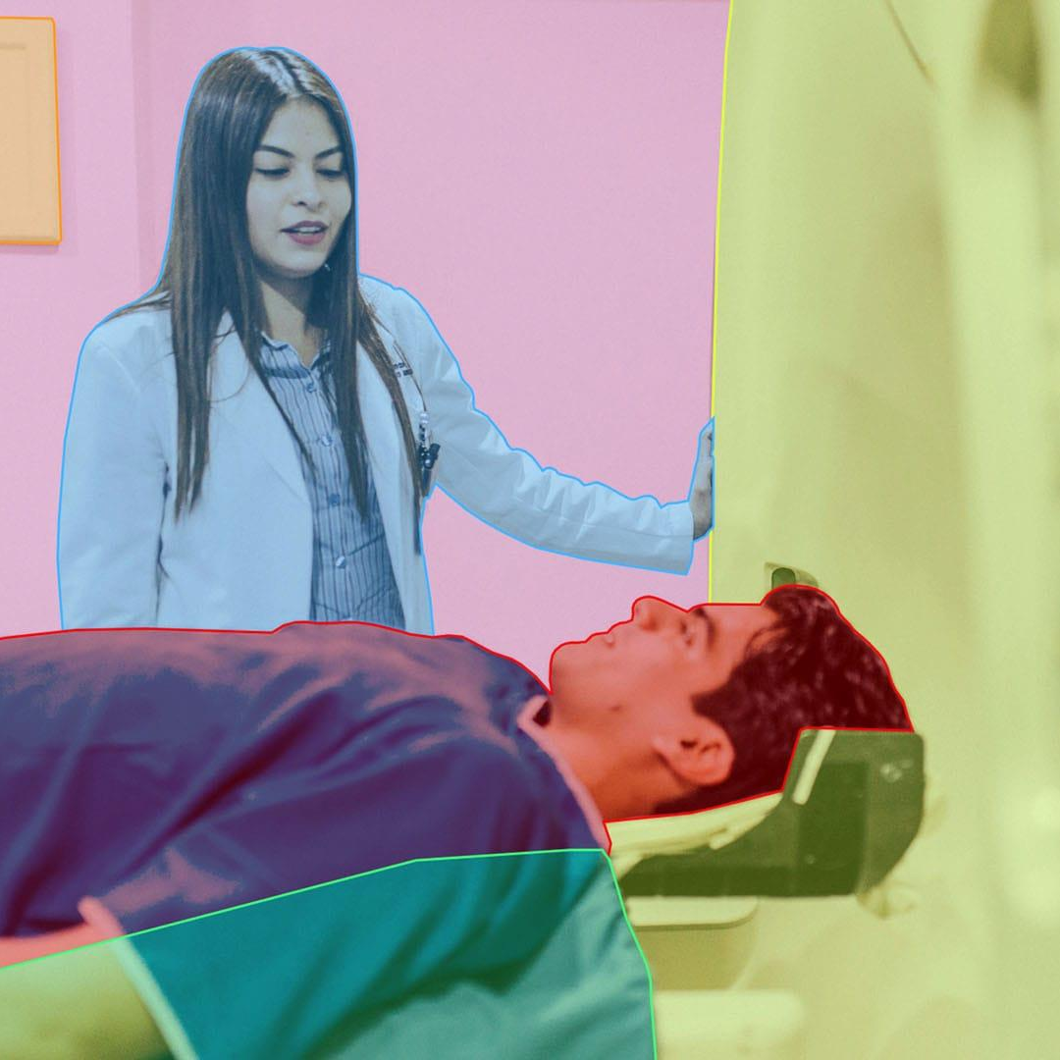
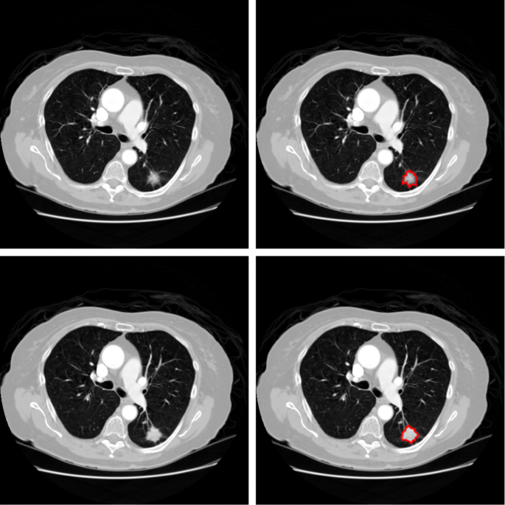
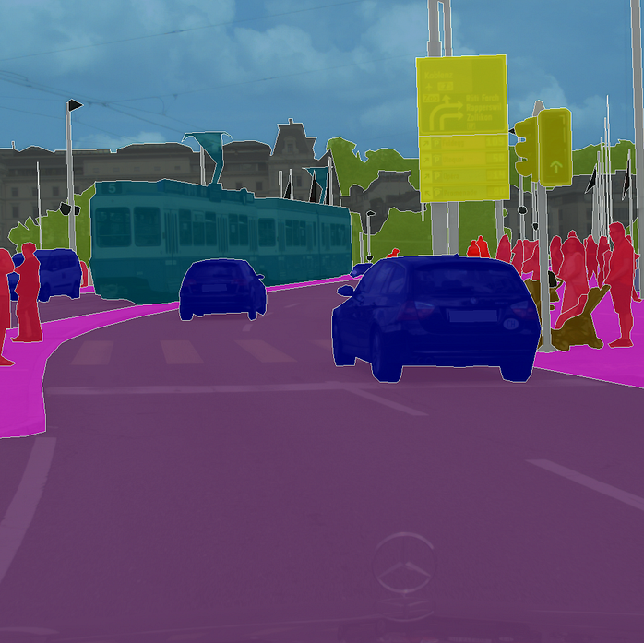
Datasets Used
SA-1B: General-purpose dataset of over 1 billion masks.
Medical Imaging: MSD and LIDC-IDRI datasets for CT/MRI anatomical detail.
Autonomous Driving: Cityscapes and KITTI for urban scene segmentation with various object scales.

Slide 7
Data Preparation
• Collection and Organization: Structured medical and autonomous driving datasets.
• Preprocessing: Normalization, format conversion, annotation alignment, augmentation.
• Partitioning: Training, validation, testing splits for balanced representation.

Slide 8
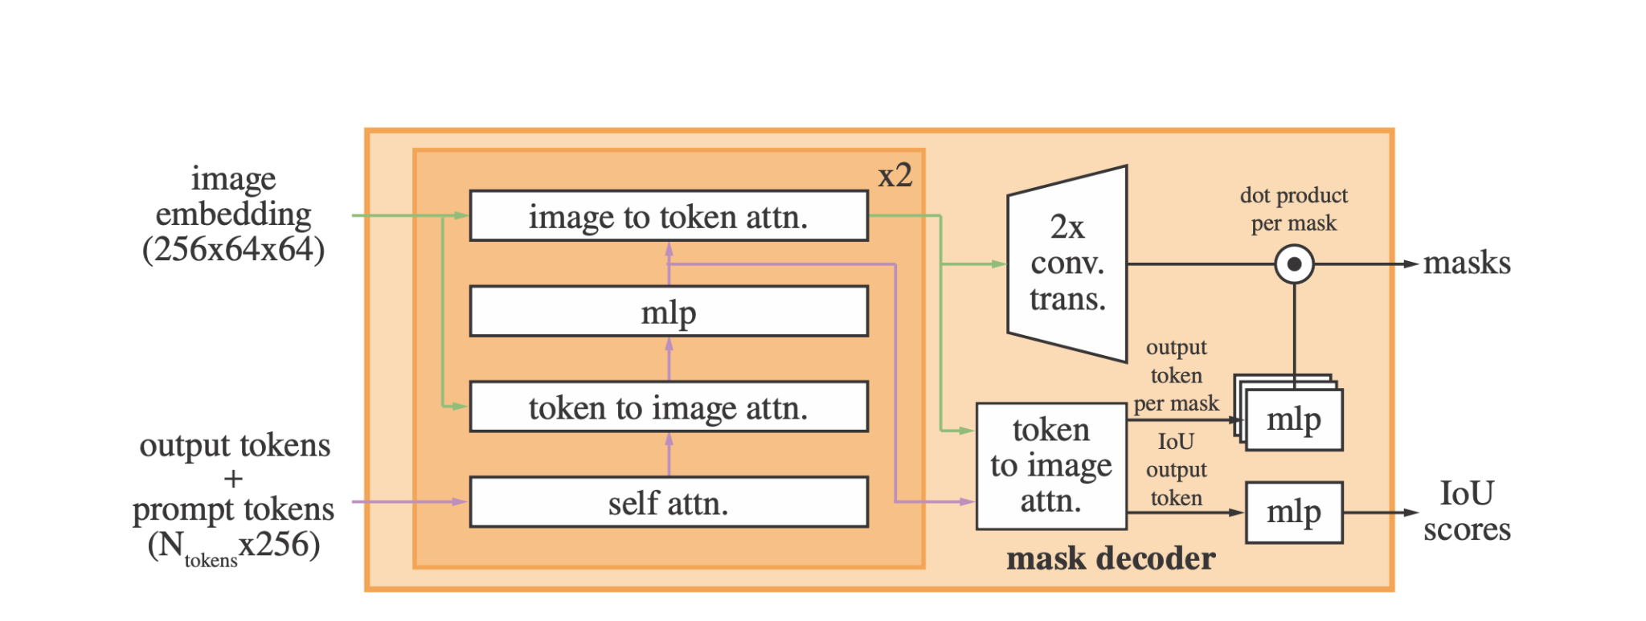
Details of the lightweight mask decoder.

Slide 9
Implementation Details
Enhanced Prompt Encoder: Self-attention, learned embeddings, hierarchical encoding.
Multi-Scale Feature Fusion: FPN and cross-resolution attention.
Domain-Specific Fine-Tuning: Optimized training on specialized datasets for accuracy.

Slide 10
Enhanced Prompt Encoder
Multi-Headed Self-Attention: Focuses on relevant image regions based on prompts.
Learned Prompt Embeddings: Develops trainable embeddings for prompt types (e.g., points, boxes) to improve precision.
Hierarchical Encoding: Encodes input at multiple scales for capturing both fine-grained details and global context.

Slide 11
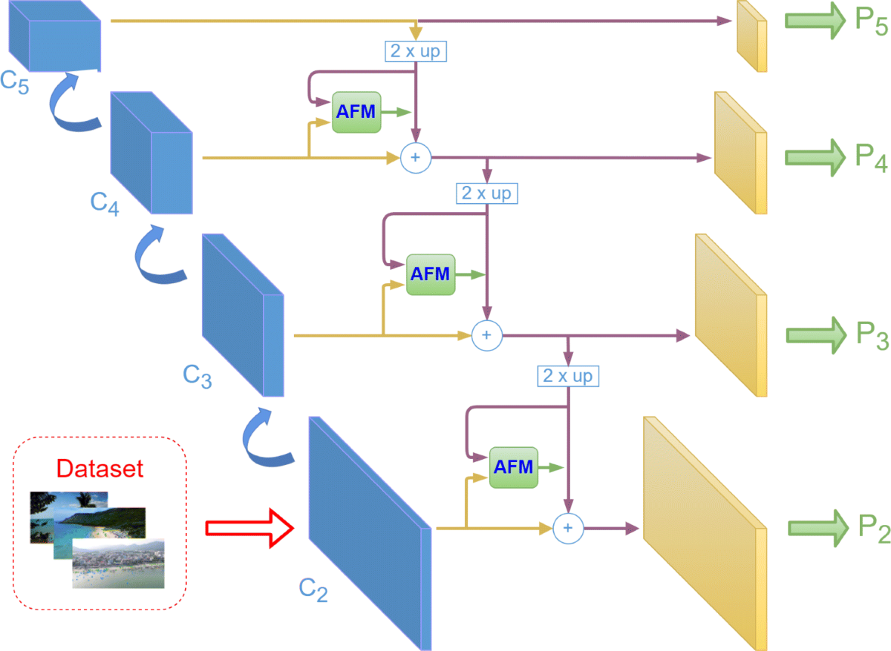
Multi-Scale Feature Fusion
Feature Pyramid Network (FPN): Extracts and fuses features across multiple resolutions for detailed segmentation.
Cross-Resolution Attention: Combines local and global context information, enabling accurate segmentation of complex spatial structures.

Slide 12
Domain-Specific Fine-Tuning
Fine-Tuning Strategy: Train SAM on datasets from specific domains to improve segmentation.
Target Datasets:
Medical Imaging: Medical Segmentation Decathlon (MSD), LIDC-IDRI.
Autonomous Driving: Cityscapes, KITTI dataset.

Slide 13

Results Analysis
Improved mIoU
Prompt Responsiveness
Adaptability
Efficiency

Slide 14
Limitations
Computational Complexity: Increased inference time from added layers.
Generalization Limits: Challenges in new domains.
Data Dependency: Relies on large, annotated datasets for fine-tuning.
Scale Scalability: Potential inefficiencies with high-res images.

Slide 15
Conclusion
Enhanced SAM with greater accuracy, adaptability, and prompt responsiveness.
Impactful in fields like medical imaging and autonomous driving.
Future Potential: SAM as a versatile tool across general and specialized domains.

Slide 16
Questions?

